Slide 1

Submitted by:-
Ashutosh Mishra
Fake News Classifier

Slide 2




Introduction
Deep NLP
&
Machine Learning
Which Deep-NLP Technique?
Fake or True ?
Background and Approach

Slide 3

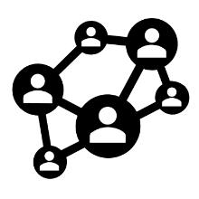


Introduction
Our goal is to build a prototype of Fake News Classifier which can be used to classify fake and true news, so that it can get controlled and restricted from spreading any antipathy or hostile news.
Libraries Explored
Motivation Behind
NLTK, RE
Scikit Learn
Numpy, Pandas
Tensorflow, Keras
See, in my previous projects I’ve worked more upon Machine learning and NLP techniques but first time what I feel like that I can perform Deep NLP i.e. with the help of neural networks we can find out the accuracy of the model as well and this really excites and stimulate me as a zeal learner.
Objective
Being a Data Scientist, I’ll be using here Long term-Short term Memory Recurrent Neural Network (LSTM RNN) model to design and optimize the result and build a prototype of fake news classifier which can be used to classify fake and hoax news.
Deep-NLP Techniques
One Hot Encoder
Embedding, LSTM, Padding
Sequential
Dropout, Dense
Porter-Stemmer, Stopwords

Slide 4
Background and Approach
Deep-NLP
Machine Learning
Natural Language Process
There has been a remarkable increase in the cases of Fake news on various social media platforms due to the forefront technology advancement. Many celebrities and politicians are facing backlashes from these hoaxes and have to come across hostile and offensive comments. This can take a toll on anyone and affect them mentally leading to depression, mental illness, self-hatred and even suicidal thoughts. Our goal is to build a prototype of fake news classifier which can be used to classify fake and hoax news so that it can be controlled and restricted from spreading hatred and antipathy.
Natural Language Process
Classification Report
Confusion Matrix
Recurrent Neural Network
Validation Accuracy & Loss
Training Accuracy & Loss
Regular Expression

Slide 5
Data Preprocessing
Text Preprocessing
Removing Special Characters
Lower Casing Alphabets
Applying English Stopwords
Stemming

Slide 6
Data Preprocessing
Vector Transformation
Vocabulary Size
One Hot Encoder
Padding
Embedding
LSTM RNN

Slide 7
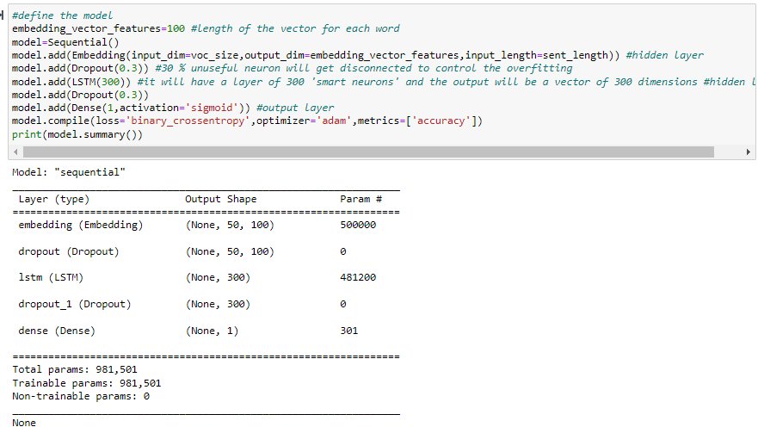
Defining Model

Slide 8
LSTM RNN
LSTM networks are a modified version of recurrent neural networks, which makes it easier to remember past data in memory. In an LSTM network, basically three gates are present-
Input gate
Forget Gate
Output Gate

Slide 9
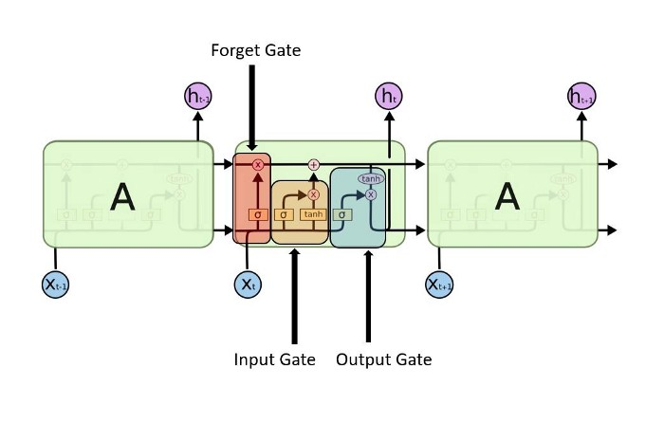
LSTM RNN

Slide 10
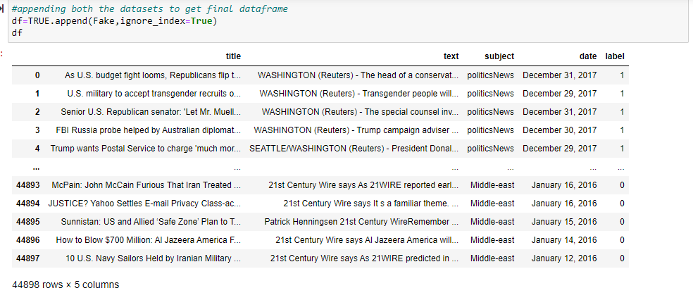
Data Source

Slide 11
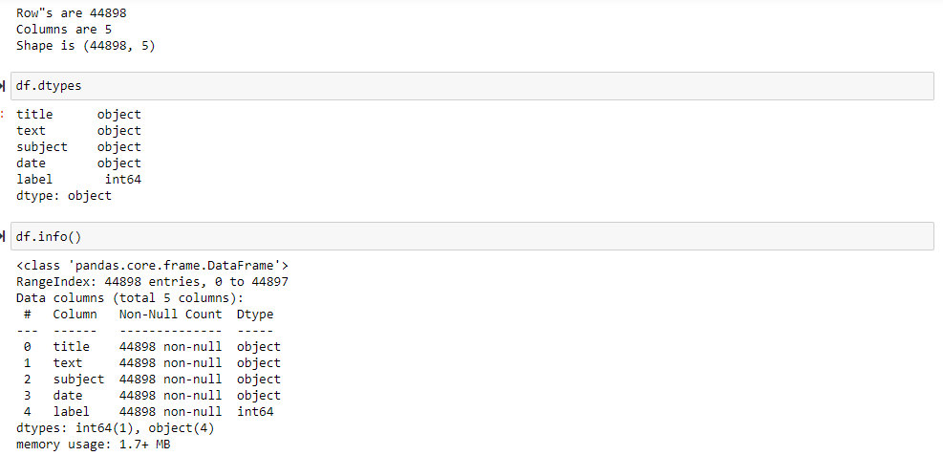
Data Source

Slide 12
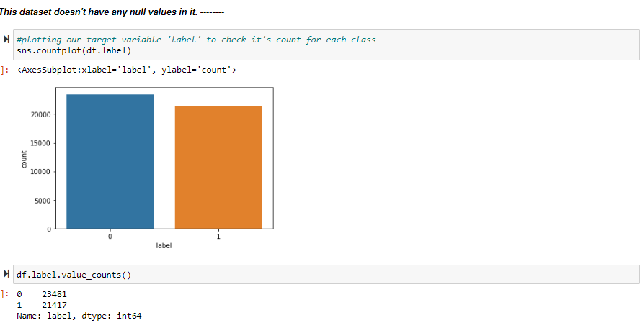
Data Source

Slide 13
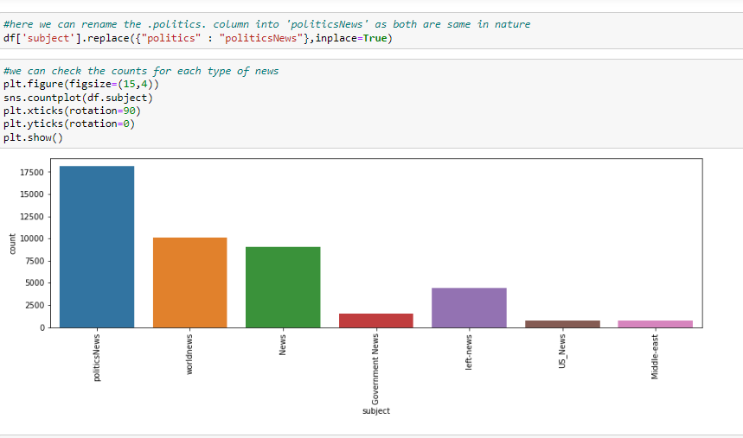
Data Source

Slide 14
Key Metrics
False Positive (Type-I error)
The predicted value was falsely predicted.
The actual value was negative (0) but the model predicted a positive value (1, True News) 71 times.
False Negative (Type-II error)
The predicted value was falsely predicted.
The actual value was positive (1) but the model predicted a negative value (0, Fake News) 68 times

Slide 15
Key Metrics
Precision Tells us how many of the correctly predicted cases actually turned out to be positive.
for fake news(0)- 99 of the correctly predicted cases actually turned out to be positive(Fake news).
for True news(1)- 98 of the correctly predicted cases actually turned out to be positive(True news).
Recall Tells us how many of the actual positive cases we were able to predict correctly with our model.
for fake news(0)- 98 of the actual positive cases (Fake news) we are able to predict correctly with our model.
for True news(1)- 98 of the actual positive cases (True news) we are able to predict correctly with our model.
F-1 Score Is basically the harmonic mean of Precision and recall
for fake news(0)- 99%
for True news(1)- 98%

Slide 16
Conclusion
At each epoch our model training loss is getting decreasing and training accuracy is getting increasing which shows that our model is performing well with LSTM RNN neural networks and it’s giving testing accuracy as 98% which is an excellent accuracy.
Also validation loss and validation accuracy is almost similar to that of Training loss and Training accuracy respectively, which indicates this model is a perfectly fit for predicting the fake news.
Training Accuracy indicates how the model is able to classify the two output during training on the training dataset. Valid Accuracy means how the model is able to classify the outputs with the validation dataset.

Slide 17
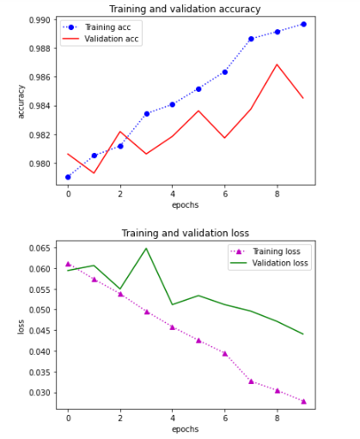
Conclusion

Slide 18
Learning Outcomes of the Study in respect of Data Science
After doing this project I got a fair idea that I can perform NLP with both Machine learning as well as Deep Learning. Also, what I’ve noticed that the time complexity with Deep NLP is less as compared to that of Machine Learning. This project has helped me in subdue my theoretical understanding better after practicing it practically.

Slide 19


Thank You !
Ashutosh Mishra
ashutoshmishra11@outlook.com
Cell No. +918208041503

